Slide 1
ROCKBUSTER STEALTH lcC
BUSINESS STRATEGY FOR 2020
Ivan Dimitrov 09.06.2023

Slide 2
Key topics and factors
MOVIES
CUSTOMERS
REVENUE
GEOGRAPHICAL REGIONS

Slide 3

Introduction
Rockbuster Stealth LLC is a movie rental company, which due to competition pressure from other streaming services, is planning to use its existing movie licenses to launch an online video rental service in order to stay competitive.
Our goal is to use our Data Analysis skills to derive meaningful insights and help the business intelligence department with the launch strategy for the new online video service.
Our key questions and objectives are:
What was the average rental duration for all videos?
Which movies contributed the most/least to revenue gain?
Which countries are Rockbuster customers based in?
Where are customers with a high lifetime value based?
Do sales figures vary between geographic regions?
What are the leading movie genres in terms of revenue/rental rate and in which countries do they prevail?
What are the leading movie MPAA ratings?

Slide 4
Background Information
Minimum Rental Duration: 3-Days
Maximum Rental Duration: 7-Days
Average Rental Duration: 5-Days
Minimum Rental Rate: 0.99
Maximum Rental Rate: 4.99
Average Rental Rate: 2.98
Minimum Movie Length: 46-minutes
Maximum Movie Length: 185-minutes
Average Movie Length: 115-minutes
Minimum Replacement Cost: 9.99
Maximum Replacement Cost: 29.99
Average Replacement Cost: 19.98
Total Movie Count: 1000-Movies
Most Common Movie Title: “Academy Dinosaur”
Most Common Movie Release Year: “2006”
Most Common Movie MPAA Rating: “PG-13”
Most Common Customer Name: “Jamie Abney”
Movie Ratings
PG, R, NC-17, PG-13, G
Language
English
Movie genres
Thriller, Sci-Fi, Comedy, War, Family, Games, Crime, Animation, Romance, Documentary, Classics, Sports, New, Children, Music, Travel, Foreign, Horror, Drama, Action.

Slide 5
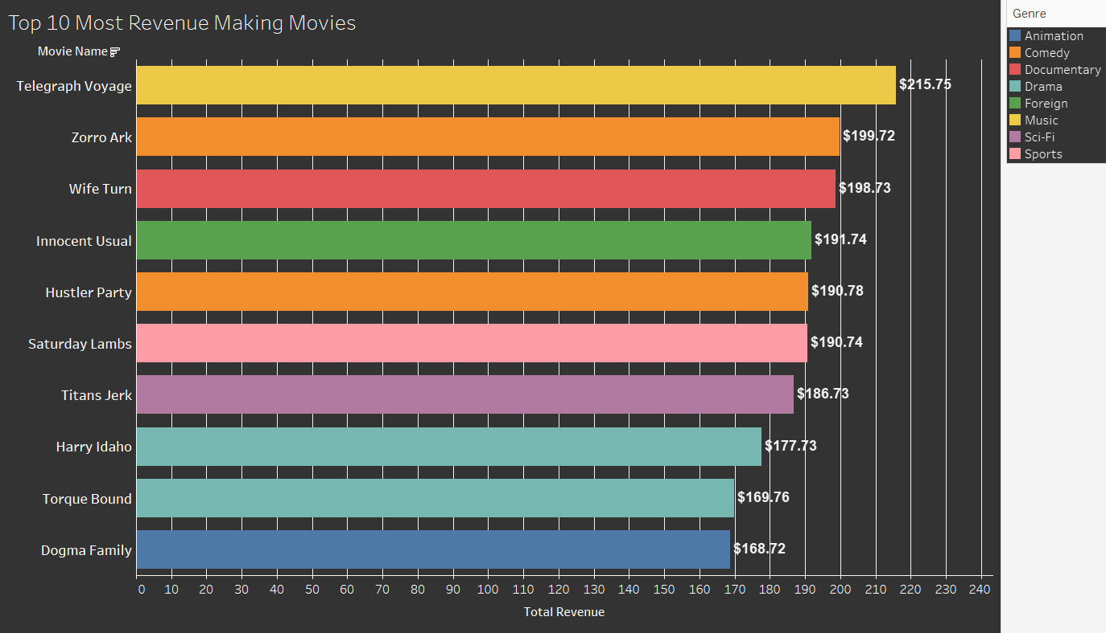
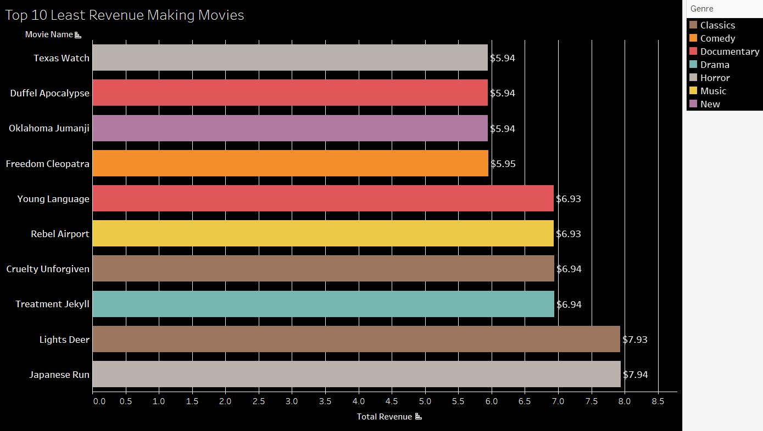
Which movies contributed the most to revenue gain?
As we can see from the chart above, the top 5 Most revenue generating movie genres are: “Music”, “Comedy”, “Documentary”, “Foreign”, and “Sports”.
As we can see from the chart above, the top 5 Least revenue generating movie genres are: “Horror”, “Documentary”, “New”, “Comedy”, and “Music”.
One conclusion we can be sure of, is that Genre is not the Revenue making factor as we see top revenue making genres present in the bottom revenue as well.

Slide 6
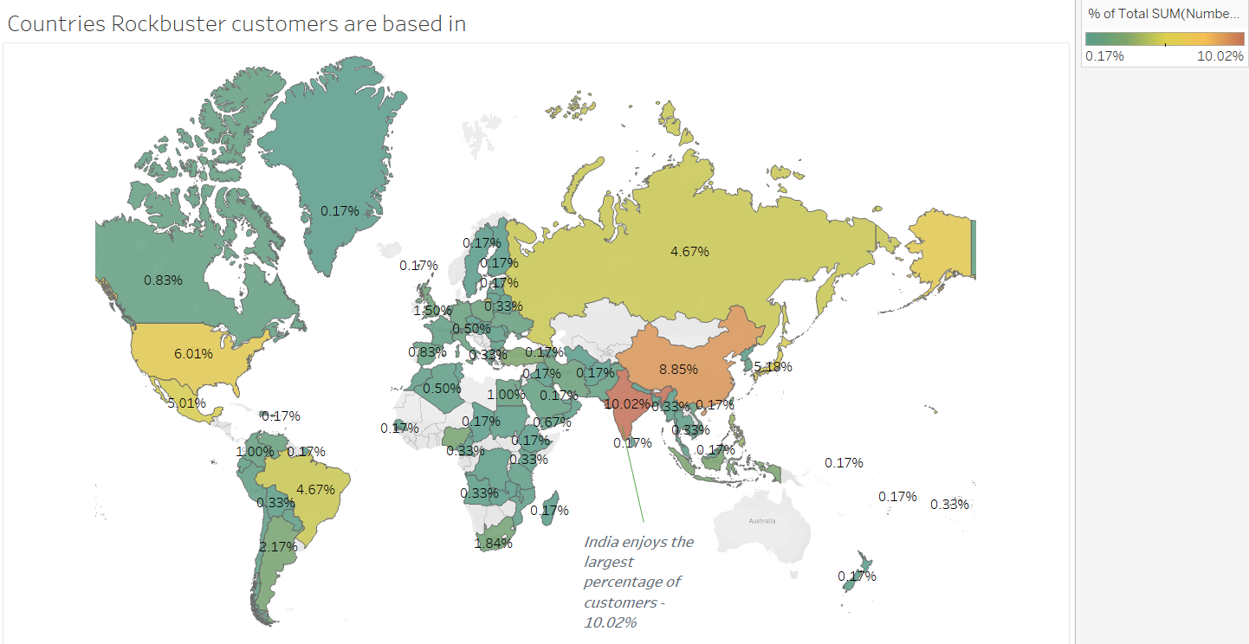
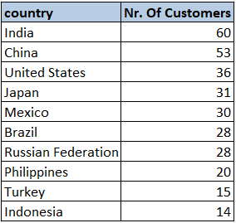
Which countries are Rockbuster customers based in?
Here we see that India has the highest Rockbuster customer count compared to all other countries, as is confirmed by the Legend on the right that 10.02% is the highest of all.

Slide 7
Top 10 Cities within the Top 10 Countries in terms of customer count
Country | City | Number of Customers
United States | Aurora | 2
Mexico | Acua | 1
United States | Citrus Heights | 1
Japan | Iwaki | 1
India | Ambattur | 1
China | Shanwei | 1
Brazil | So Leopoldo | 1
Russian Federation | Teboksary | 1
China | Tianjin | 1
Indonesia | Cianjur | 1
The only city with more than 1 customer is “Aurora” in the US. This however is an example of missing correlation between customer count and cities, because all the customers are spread out evenly. In India for example, where the biggest amount of customers are (60), there are 60 cities with 1 customer in them.

Slide 8
Where are customers with a high lifetime value based?
Country | City | Customer First Name | Customer Last Name | Total Amount Paid
India | Ambattur | Arlene | Harvey | $111.76
China | Shanwei | Kyle | Spurlock | $109.71
Japan | Iwaki | Marlene | Welch | $106.77
Mexico | Acua | Glen | Talbert | $100.77
United States | Aurora | Clinton | Buford | $98.76
Incentivizing these customers is a good idea.

Slide 9
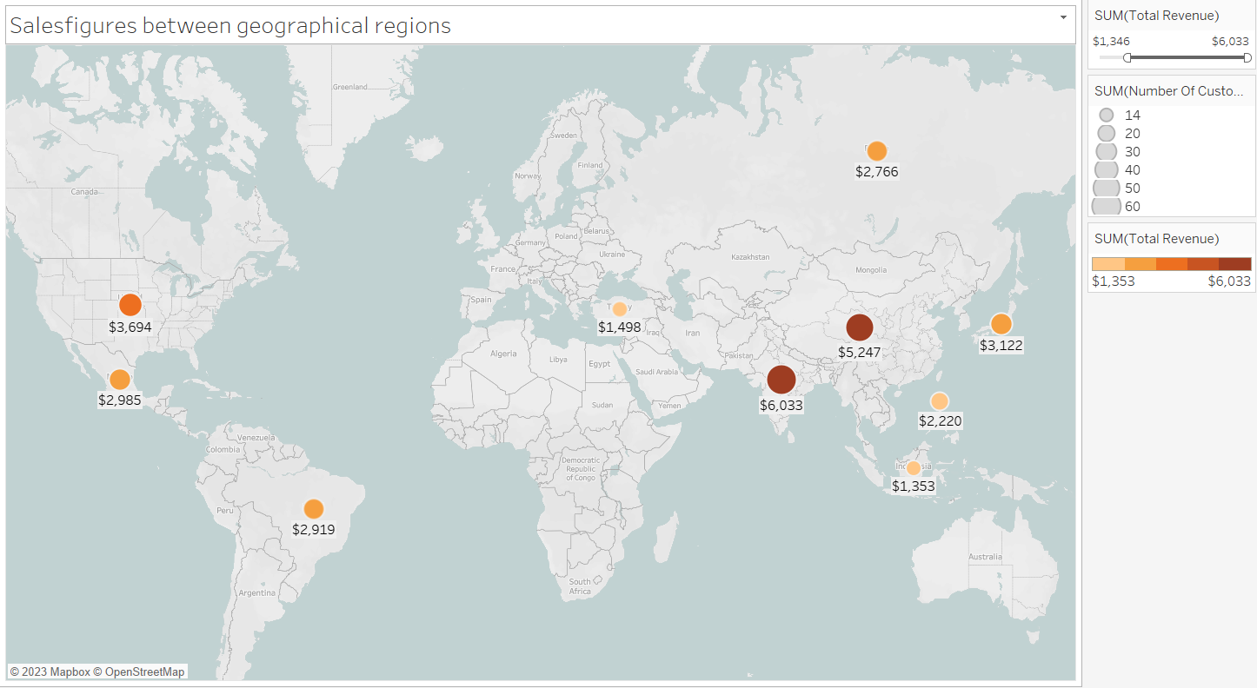
Do sales figures vary between geographic regions?
As we can see the Top 10 countries in terms of revenue are: “India”, “China”, “United Stated”, “Japan”, “Mexico”, “Brazil”, “Russian Federation”, “Philippines”, “Turkey”, “Indonesia”.

Slide 10
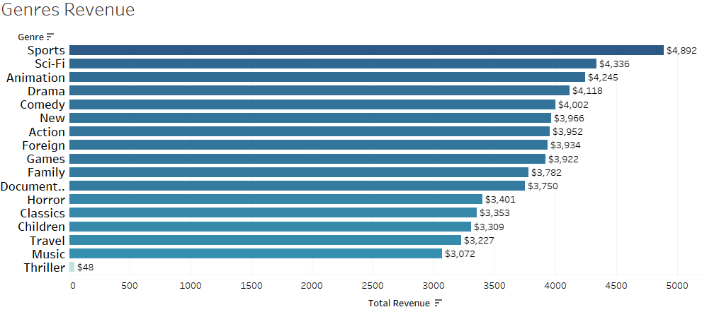
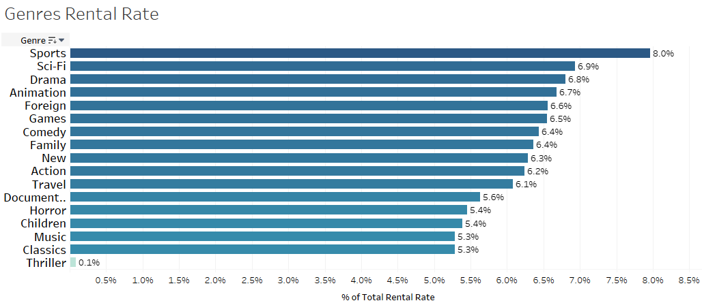
What are the leading movie genres in terms of revenue/rental rate?
We can see here, that there’s a very little to none difference between revenue and rental rate in terms of the movie genre.
However we look at it the leading movie genres stay as followed: “Sports”, “Sci-Fi”, “Animation”, “Drama”

Slide 11
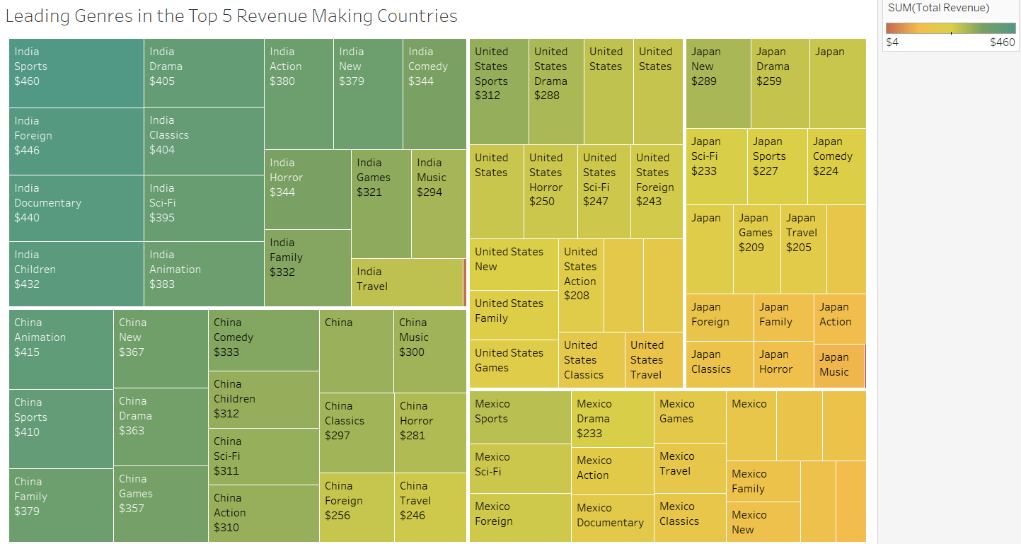
Leading Genres
The leading genres for India, United States and Mexico are “Sports”. Whereas in China it’s “Animation”, and in Japan it’s “New”.

Slide 12
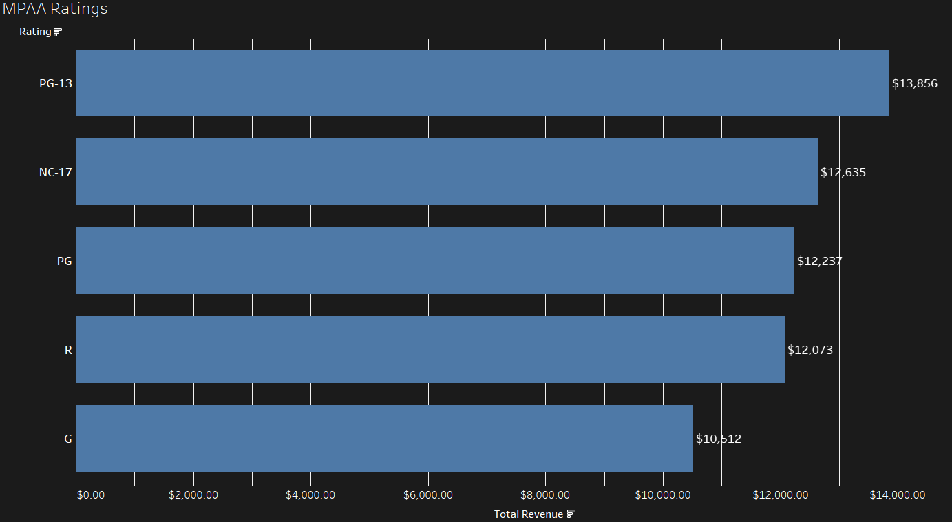
What are the leading movie MPAA ratings?
We can see here that PG-13 is the most revenue bringing MPAA rating. Followed by NC-17, PG and R. But once again there is no significant difference and we can not exclude the G rating out of the equation.

Slide 13
Conclusion
Rockbuster Stealth LCC has customers based all over the world.
The customers with high lifetime value and also the biggest revenue drivers reside in India, China, Japan, Mexico and the United States.
The top 5 revenue making customers are: Arlene Harvey, Kyle Spurlock, Marlene Welch, Glen Talbert, Clinton Buford.
All movie ratings have a significant presence, but PG-13 and NC-17 hold the top two spots.
The leading genres for India, United States and Mexico are “Sports”. Whereas in China it’s “Animation”, and in Japan it’s “New”.
All of the movies are in English and have been released in 2006.
The top 5 movies in terms of revenue are not an example of profitable movie genres.

Slide 14
Recommendations
Get more movies from different release years, as we only have movies from 2006.
Invest in incentivizing our top performing customers. (loyalty cards, discounts, special gifts etc.)
Focus on loading more Sports, Sci-Fi, Animation, Drama and Comedy movies.
Invest in promoting Sports, Foreign and Documentary movies for India. Animation, Sports and Family for China. Sports, Drama and Documentary for US. New, Drama and Animation for Japan. Sports, Sci-Fi and Foreign for Mexico.
When it comes to launching a new online streaming service, the visual design will play a crucial role. Therefore discuss the visuals with the design team to further boost customer interest.

Slide 15
Thank you for your attention
Link to my Tableau Visualizations
Ivan Dimitrov 09.06.2023

